Slide 1
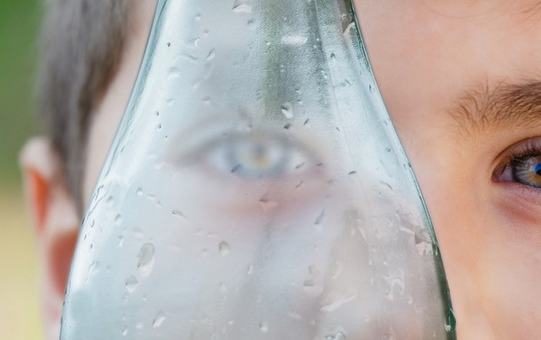
O-I Advances Glass Packaging's Sustainability Profile

Slide 2
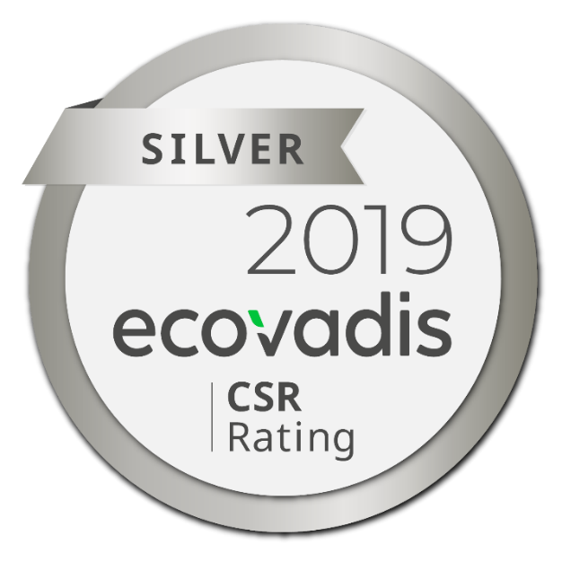
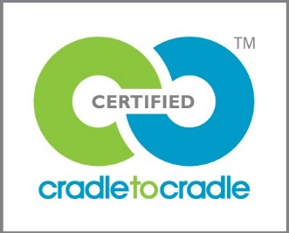
Premier product sustainability certification recognized globally and across industries.
Validation of O-I's ongoing commitment to sustainability and continuous improvement.
Scored Higher in three out of five categories.
94% of global glass operations certified.
World's most trusted provider of business sustainability performance for global supply chains.
Provides transparency around O-I’s Corporate Social Responsibility activities.
Improved from Bronze to Silver rating.

Slide 3
The Benefits of Sustainability Reporting…
Mitigating or reversing environmental, social and governance impacts.
Increasing stakeholder understanding of organization’s true value, and tangible and intangible assets.
Improving reputation and brand loyalty.
…And More!

Slide 4
Cradle to Cradle
Improved from Gold to Platinum in Material Health category
Only food and beverage packaging company to receive Platinum in Material Health for the total package
Improved to Gold in Water Stewardship for providing analysis of waste water discharge.
Improved to Silver in Social Fairness for community outreach initiatives taking place in our communities where we operate.
Overall rating, Bronze, is unchanged, and is reflective of the work underway to increase renewable energy sources in our operations.

Slide 5
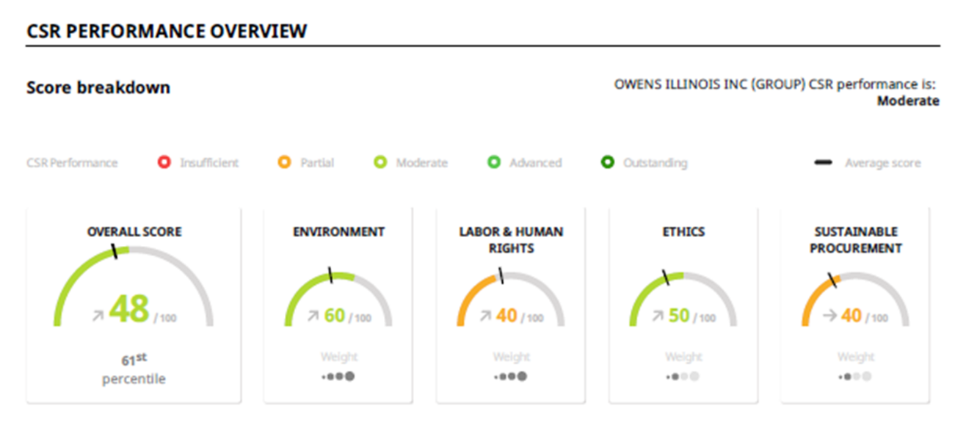
EcoVadis
Measures Corporate Social Responsibility in the areas of Environment, Labor and Human Rights, Ethics and Sustainable Procurement
Methodology includes CSR standards from Global Reporting Initiative Framework, United Nations Global Compact and ISO Certification
O-I ranks in top 61% – EcoVadis considers this quite an accomplishment in the Packaging Sector
O-I’s assessment score ranks several points high than industry average for companies our size and scope

Slide 6
Similarities
Differences
Both third-party, non-profit certification organizations
Highly regarded across industries
O-I certification achieved through collaboration across functions and regions
The right thing to do – consumers want companies to act responsibly and be transparent
Different categories/criteria measured
EcoVadis recertification in 2020
Cradle to Cradle recertification in 2021

Slide 7
TAKEAWAYS
THIRD PARTY, TRANSPARENT SUSTAINABILITY CERTIFICATIONS
STRONG PROOF POINT
FOR YOUR CONSUMERS
NEED MORE INFO? CONTACT: jim.nordmeyer@o-i.com
sutapa.bhaduri@o-i.com

